Slide 1
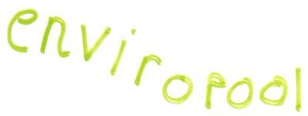
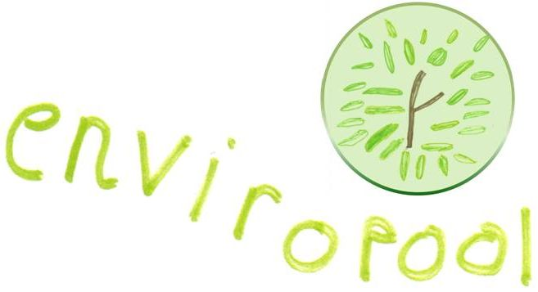
.co.uk
enviropool.co.uk

Slide 2
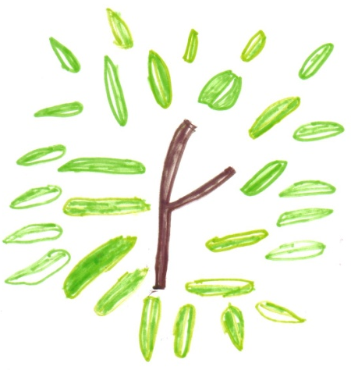
.co.uk
natural materials
.co.uk

Slide 4
enviropool
Good for us.
Good for our city.
Good for the Planet.

Slide 5
enviropool
Good for us.
Good for our city.
Good for the Planet.

Slide 6
en-vi-ro-,
( /ɛn’vʌɪrəʊ /, US. / ən’vɑiroʊ / )
adjective.
1. beneficial to the natural surroundings in which we live; regarding the environment.
-pool,
( /pu:l/ )
noun.
1. a collection of natural resources
enviropool
natural materials
for home and school

Slide 7
en-vi-ro-,
( /ɛn’vʌɪrəʊ /, US. / ən’vɑiroʊ / )
adjective.
Good for the natural surroundings in which we live;
All about the environment.
-pool,
( /pu:l/ )
noun.
A collection of natural resources
The city of Liverpool in the United Kingdom.
enviropool
natural materials
for home and school

Slide 8
Natural things are very important for young people’s learning.
Natural materials can be found everywhere; in our parks, by our coastline; in fact all over our wonderful city.
We are getting everyone out into those places to collect natural things for us. Its great fun and brings families together.
It keeps us all healthy and helps make us realise what a beautiful natural place we live in.
Natural things
自然的東西
الأشياء الطبيعية
are important
是重要的
هي مهمة
We make great things from what we collect - just look at our website.
And best of all … the money we make is used to improve our school, our community and the environment … for everyone.
Simple … and beautiful.
Enviropool. Good for us. Good for our city. Good for the Planet.
for learning
為學習
لتعلم

Slide 9
en-vi-ro-pool,
( /ɛn’vʌɪrəʊ’pu:l/, US. /ən’vɑiroʊ’pu:l/ )
noun.
1. beneficial to the natural surroundings in which we live; regarding the environment.
2. a collection of natural resources

Slide 11
.co.uk
natural materials

Slide 12
.co.uk
natural materials

Slide 13
.co.uk
natural materials
.co.uk
natural materials

